Slide 1
REGIONAL WORKFORCE HOUSING NEEDS ASSESSMENT
2021 UPDATE
Notes:
This is an update from 2016
We worked with the prior methodology – making adjustments only where necessary to support future updates

Slide 2
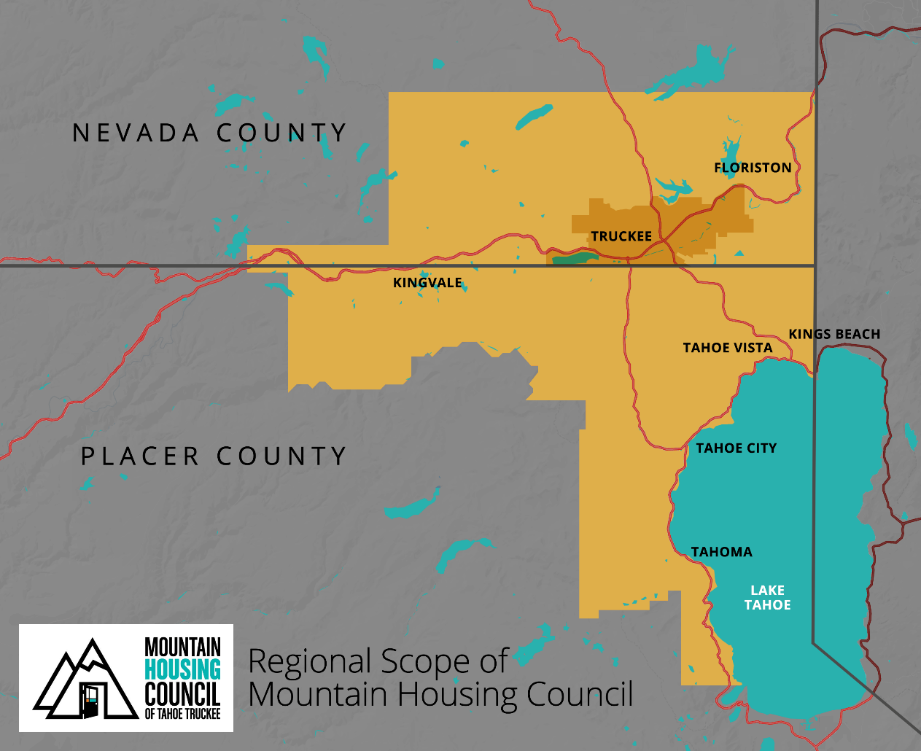
REGIONAL CONTEXT
The North Tahoe-Truckee region, as defined by the Mountain Housing Council, is approximately 550 square miles and is characterized by the same boundaries as the Tahoe Truckee Unified School District and the Truckee Tahoe Airport District.
Notes:
Multiple jurisdictions working together, facilitated by Mountain Housing council, to advance housing in our region.

Slide 3
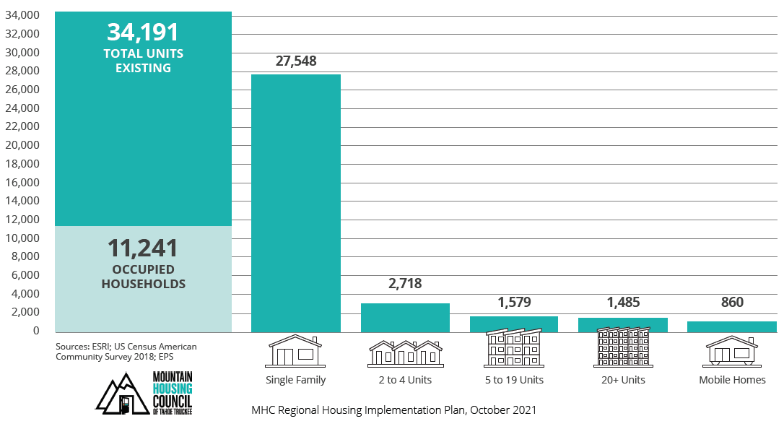
OVERVIEW OF EXISTING HOUSING INVENTORY

Slide 4
UNMET HOUSING NEEDS IN OUR REGION
REGIONAL WORKFORCE HOUSING NEEDS ASSESSMENT

Slide 5
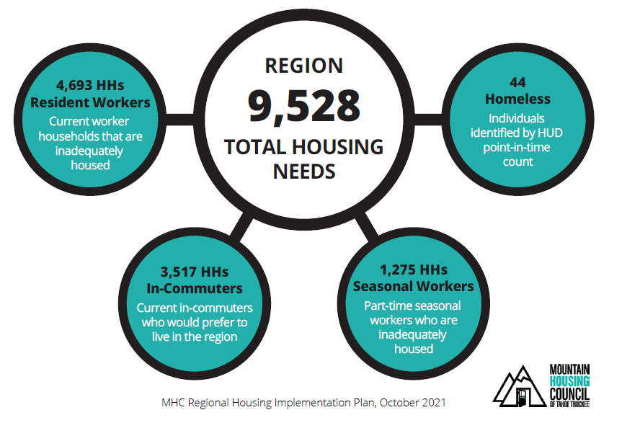
BOTTOM LINE: REGIONAL UNMET HOUSING NEED
Totals For Sub-Geographies:
Resident Workforce Households
Truckee: 2,469
East Placer: 1,847
East Nevada (non-Truckee): 377
In-Commuter Households
Truckee: 1,618
East Placer: 1,229
East Nevada (non-Truckee): 670
Seasonal Workers Households
Truckee: 627
East Placer: 469
East Nevada (non-Truckee): 179
Homeless
Truckee: 28
East Placer: 16
East Nevada (non-Truckee): 0

Slide 6
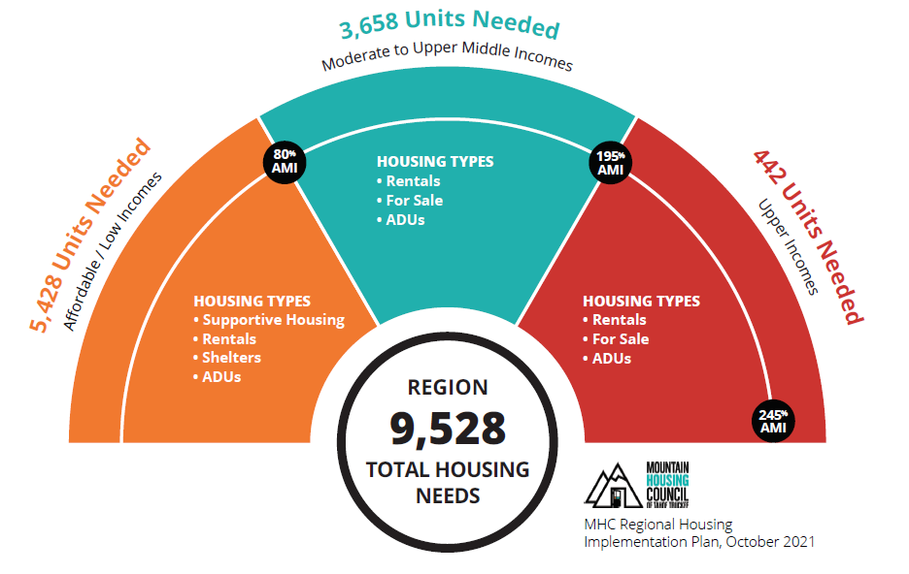
REGIONAL UNMET NEED BY INCOME
MHC 1.0
Achievable Housing Cap

Slide 7
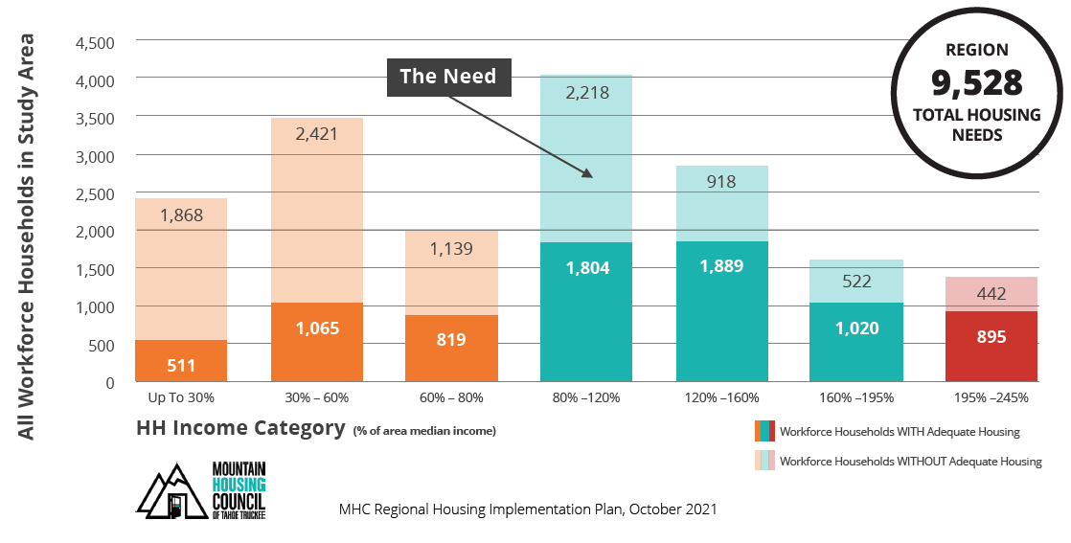
REGIONAL HOUSEHOLD NEED BY INCOME CATEGORY

Slide 8
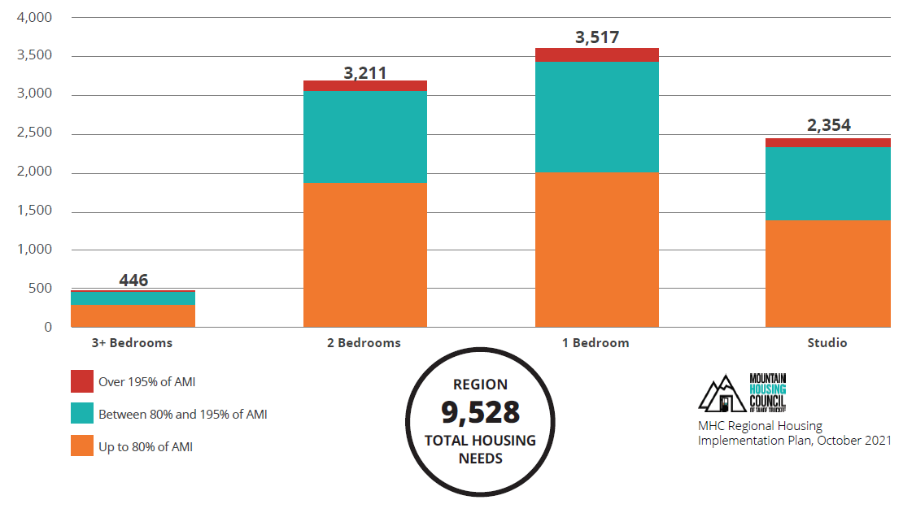
HOUSING NEEDS ESTIMATES – UNIT SIZES REQUIRED

Slide 9
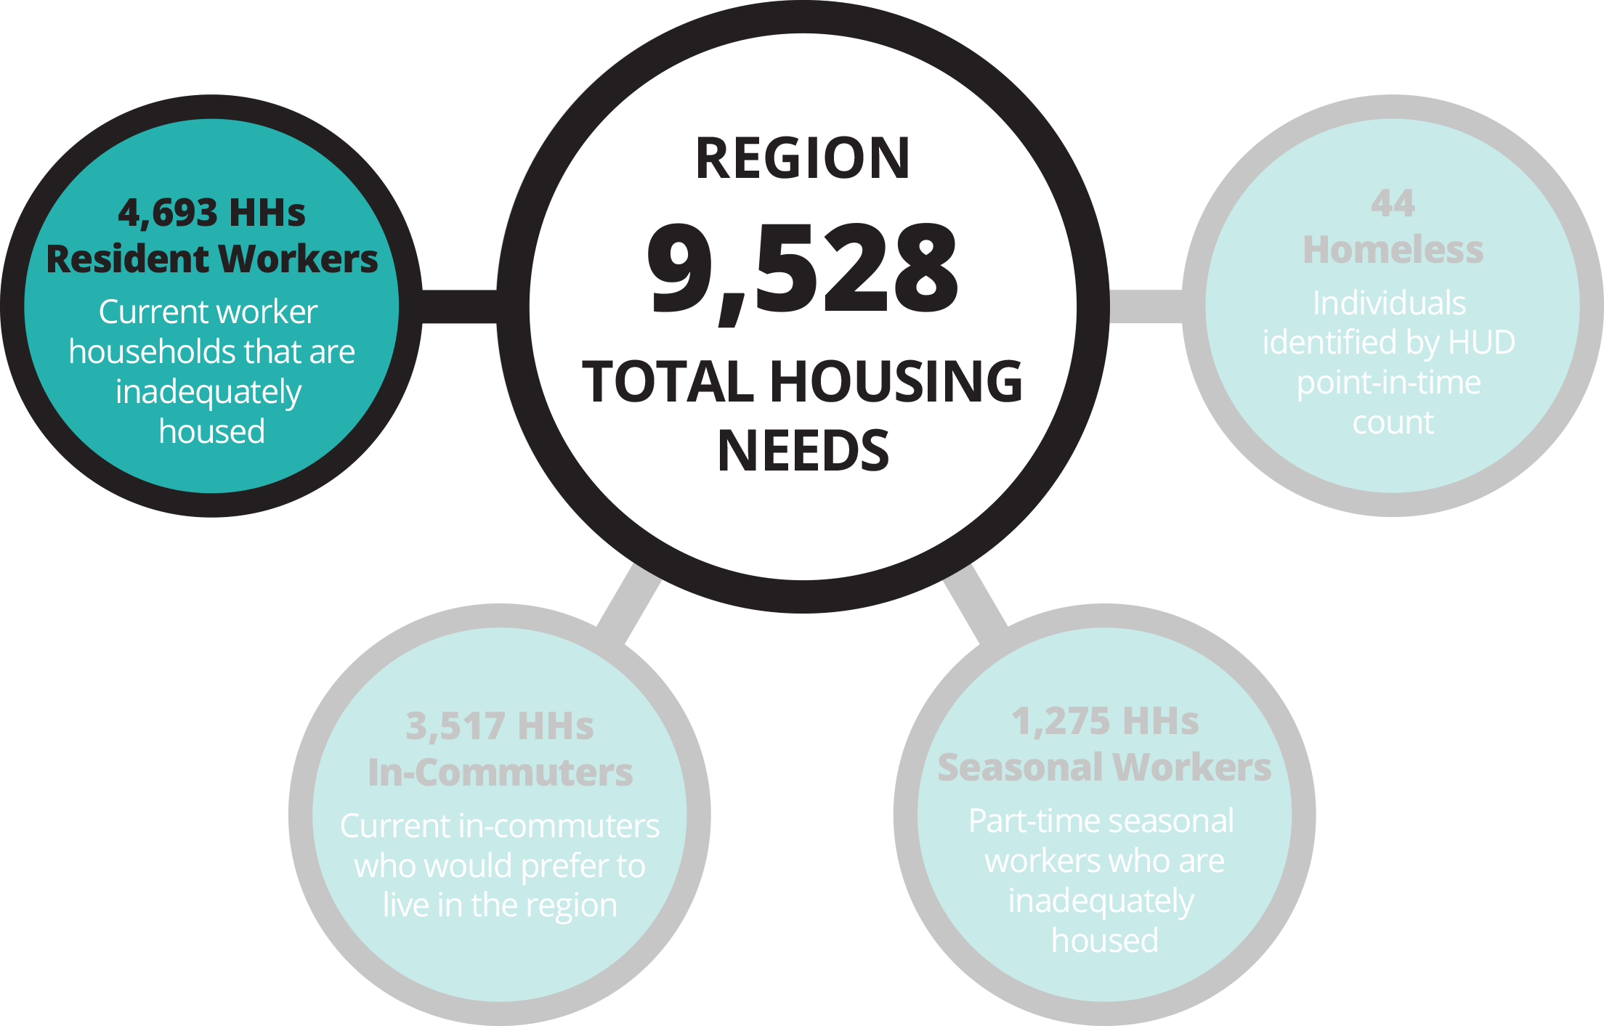

CURRENT RESIDENT WORKFORCE HOUSEHOLDS THAT ARE INADEQUATELY HOUSED
RESIDENT HOUSEHOLDS COHORT

Slide 10
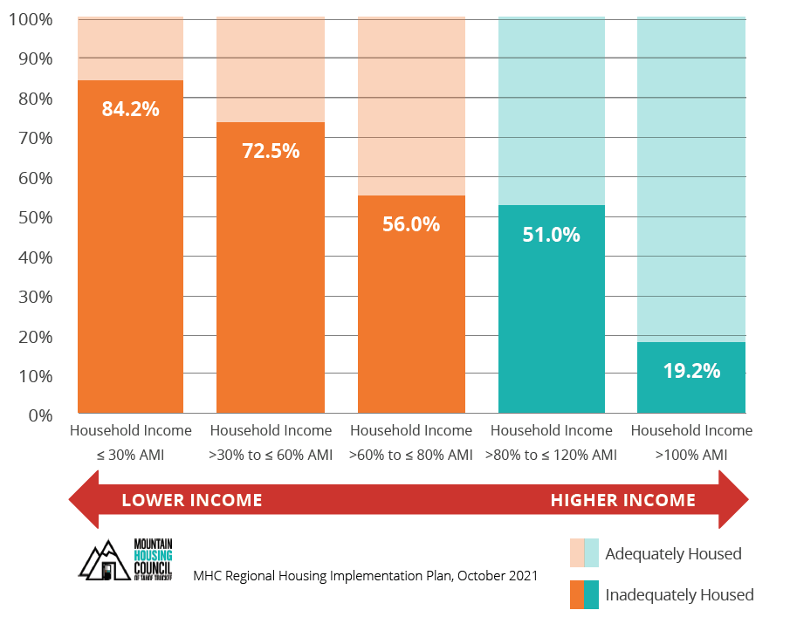
INADEQUATELY-HOUSED RESIDENT WORKERS
4,693 inadequately-housed resident households in the region
Inadequately housed
refers to households that are:
  Overburdened
  (>30% of income spent on housing)
  Overcrowded
  (>1 person per room)
  Underhoused
  (lack of plumbing or kitchen facilities)
Source: U.S Department of Housing and Urban Development
Comprehensive Housing Affordability Strategy Survey 2013-2017

Slide 11
Working Senior Households
Working Senior Households are a subset of resident workers.
More than 600 households occupied by working seniors are inadequately housed.
  Estimated using proportion of total Study Area seniors in workforce, assuming 1.6 working seniors per household (i.e., some working seniors live together)

Slide 12
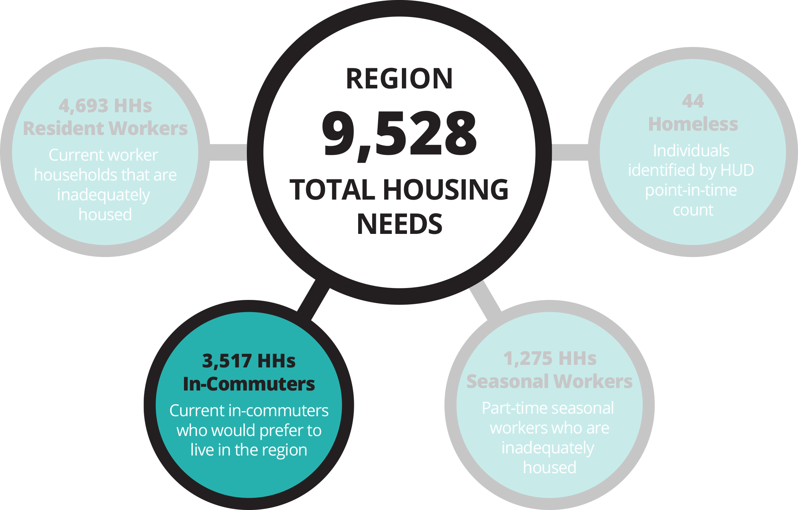
CURRENT COMMUTERS INTO THE REGION WHO WOULD PREFER
TO LIVE IN THE REGION
IN–COMMUTER HOUSEHOLDS COHORT

Slide 13
IN-COMMUTER HOUSEHOLDS
In-Commuting Workers: 8,968 Individuals
In-Commuting Households: 5,605 Households
(@ 1.6 workers per household)
“Somewhat Likely” or “Very Likely” to Relocate: 84% (4,618 Households)
“Very Likely” to Relocate: 63% (3,517 Households)
U.S Census LEHD 2018
Inflow-Outflow (Total Workers)

Slide 14
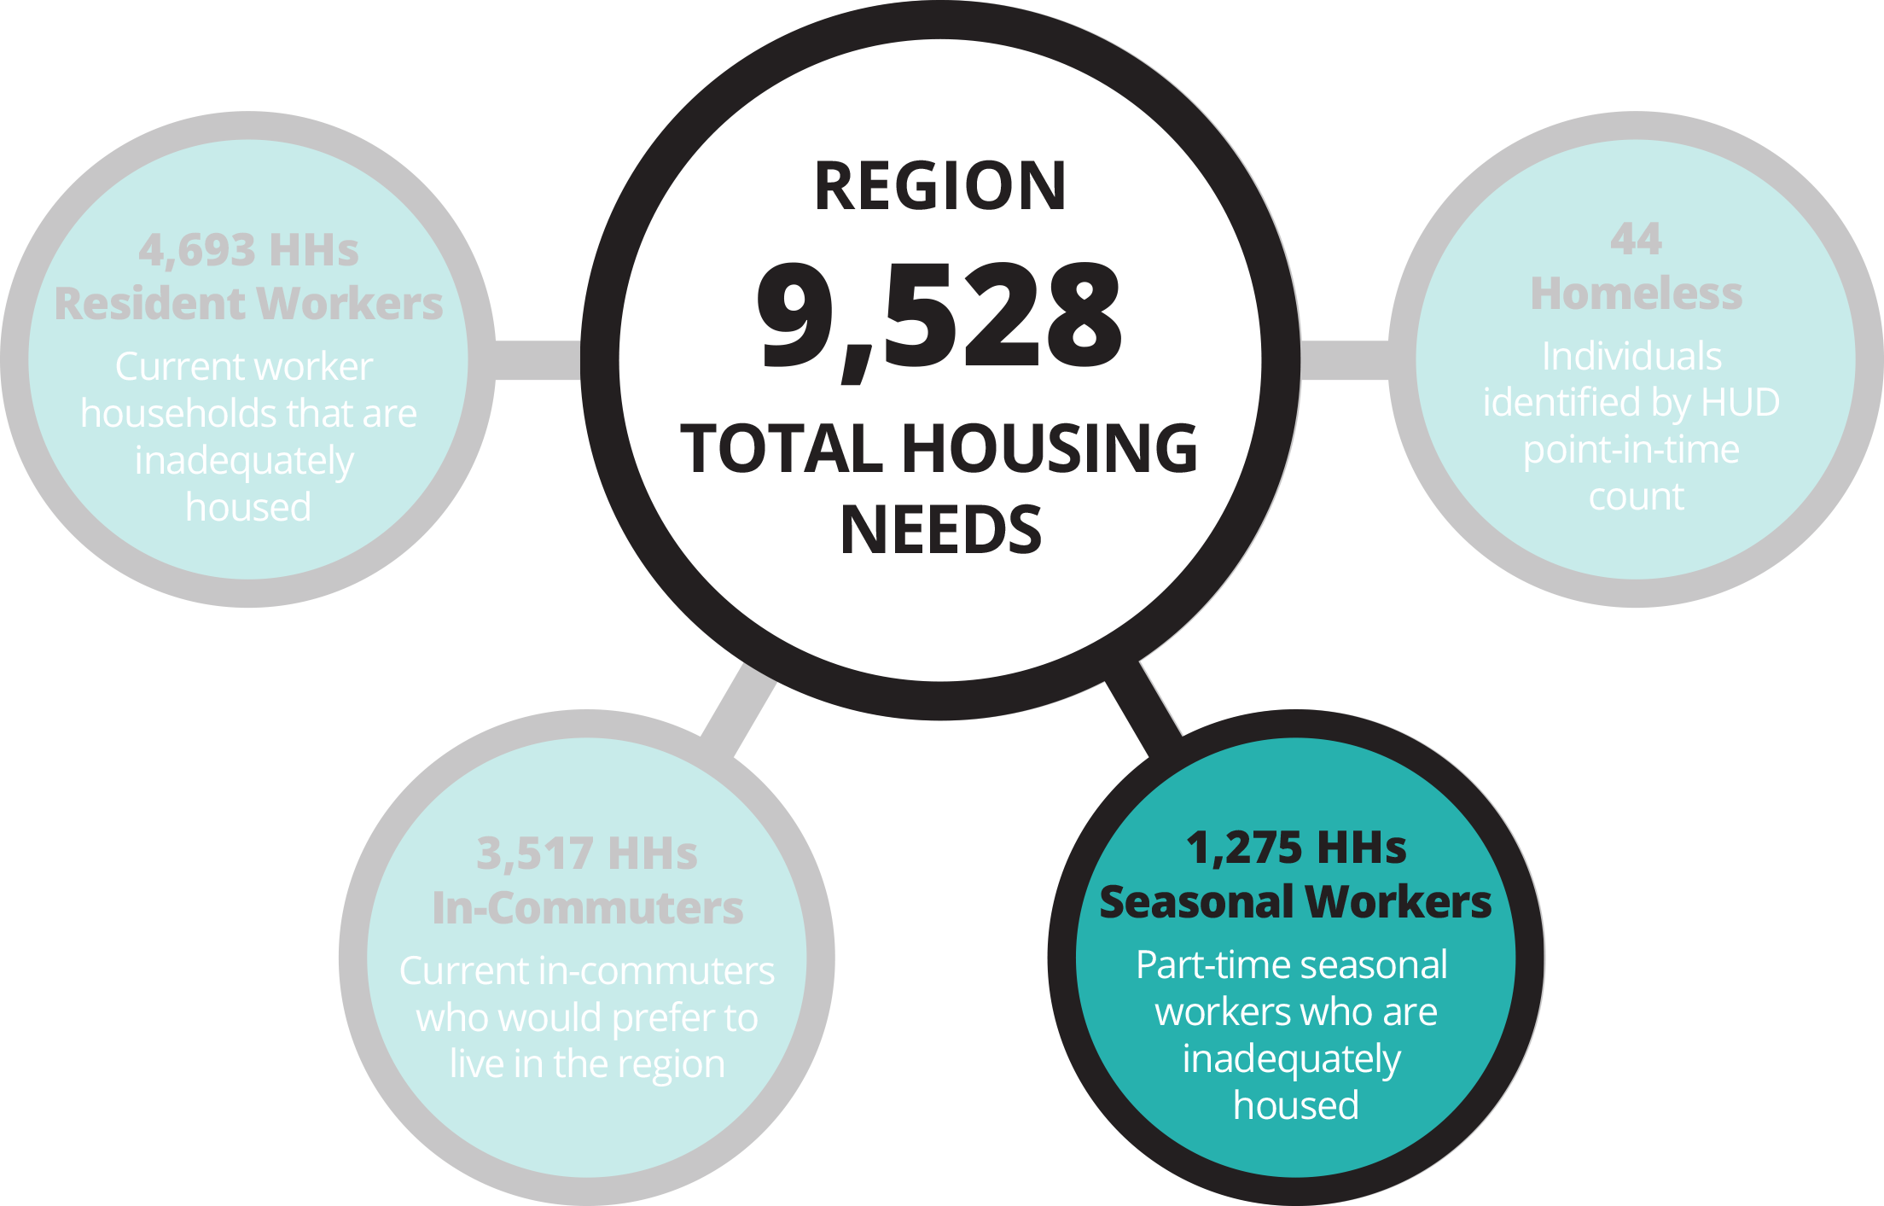
PART-TIME SEASONALWORKS WHO ARE INADEQUATELY HOUSED
SEASONAL WORKERS COHORT

Slide 15



SEASONAL WORKERS
Seasonal Workers
Estimated unmet need for seasonal worker households is 1,275 units at 1.6 workers per HH, BUT most appropriate to think of in terms of “beds”
  Unmet need for approximately 2,000 beds / individuals
  Opportunity for employer-led assistance
A higher proportion of Seasonal Workers fall into lower income categories, according to 2021 MHC Survey
Seasonal Workers tend to live in larger households

Slide 16
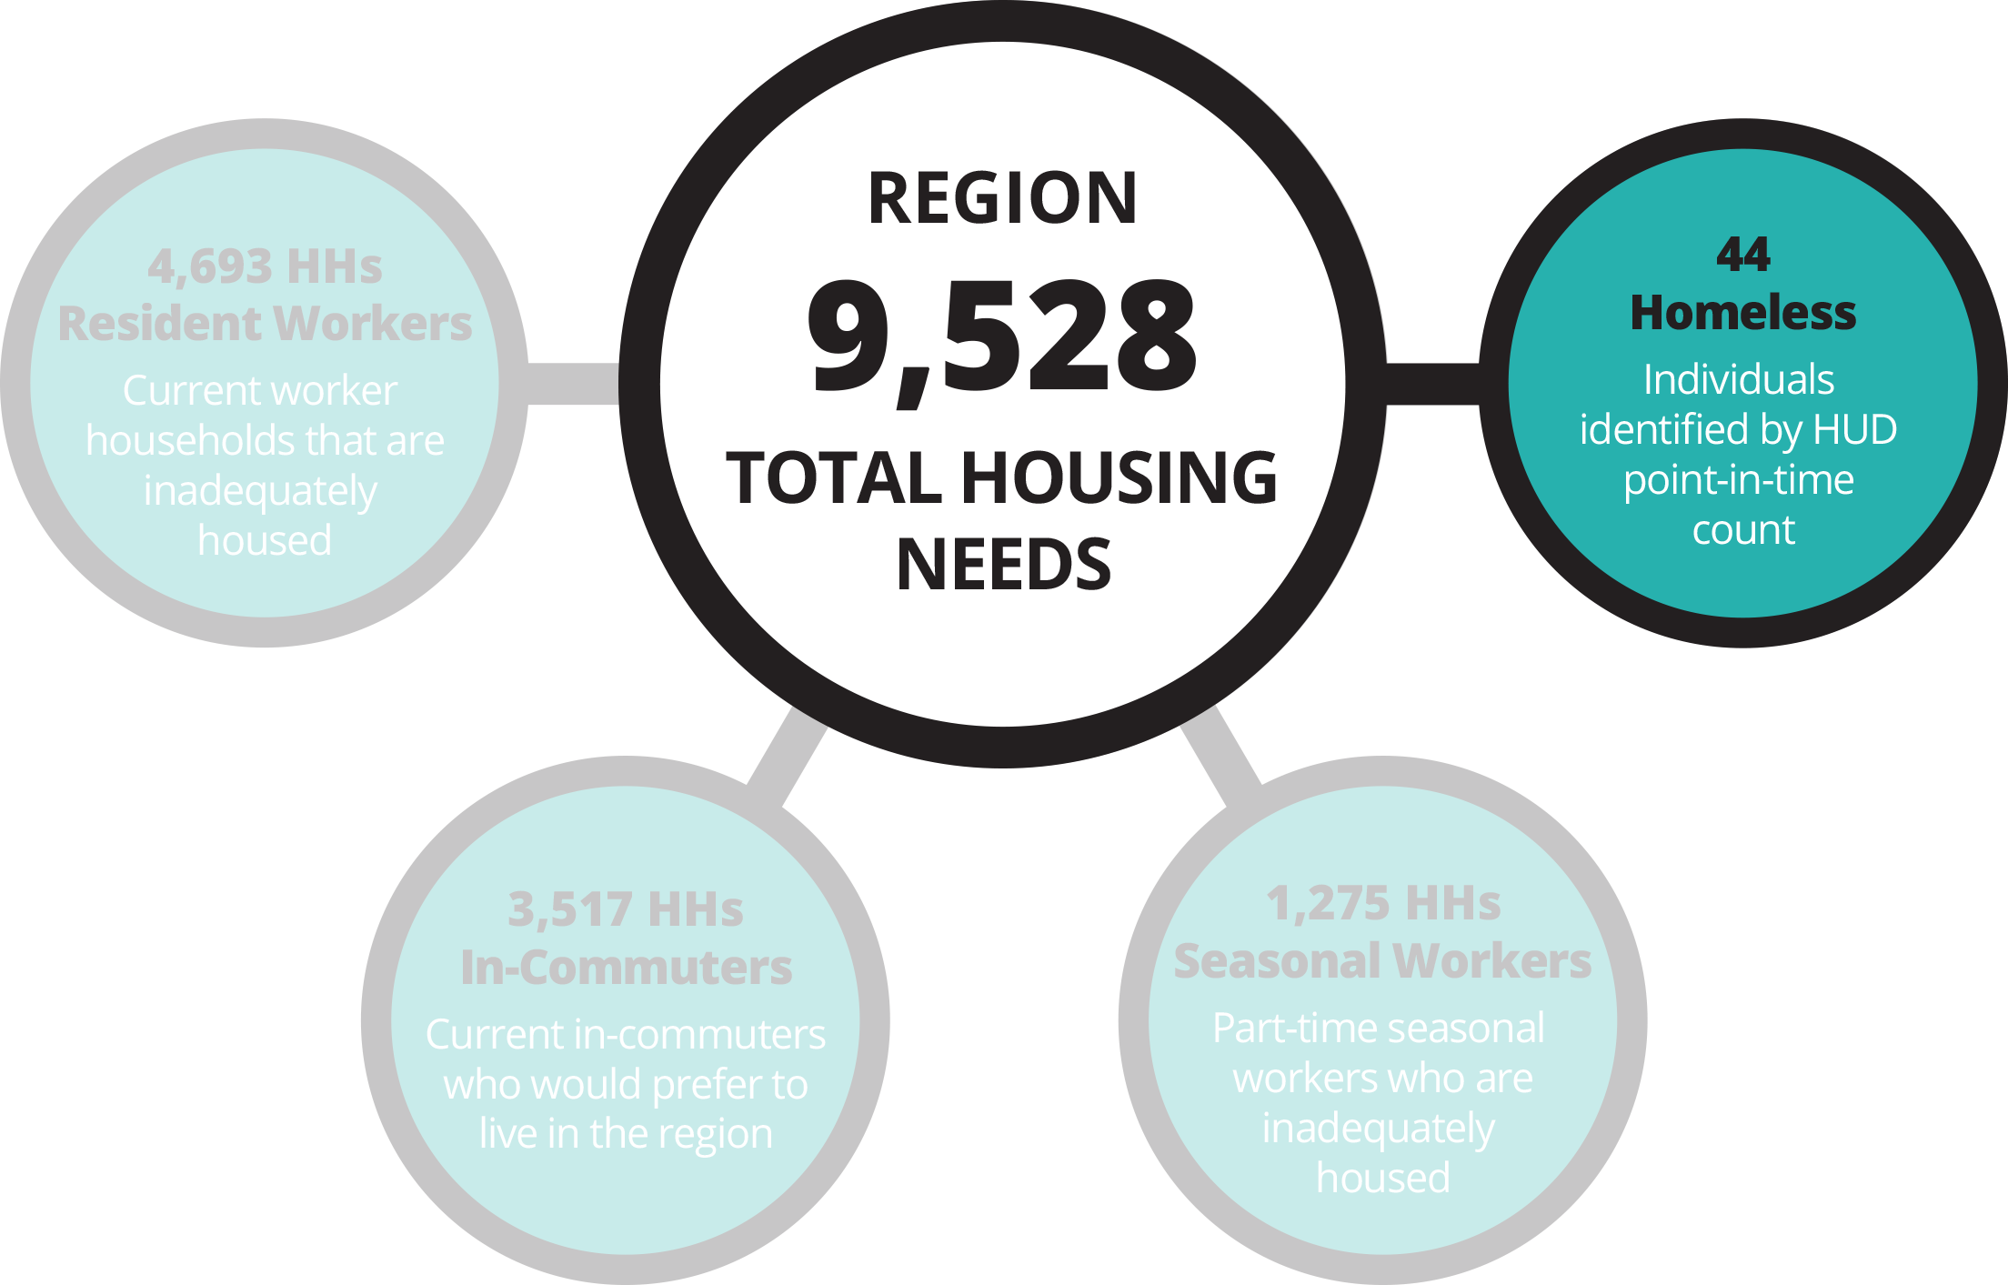
INDIVIDUALS IN OUR COMMUNITY WITHOUT DEPENDABLE SHELTER
HOMELESS COHORT

Slide 17
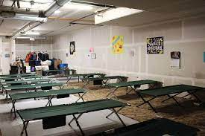
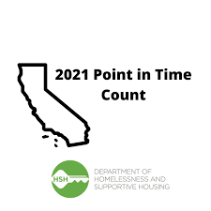
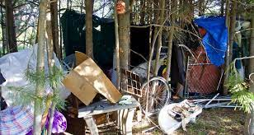
HOMELESS
Homeless
Estimate based on annual Point-in-Time Study released in January 2021
44 individuals (likely understated)
  20 chronically homeless

Slide 18
EMPLOYER AND EMPLOYEE RESPONSES
COMMUNITY HOUSING SURVEY

Slide 19
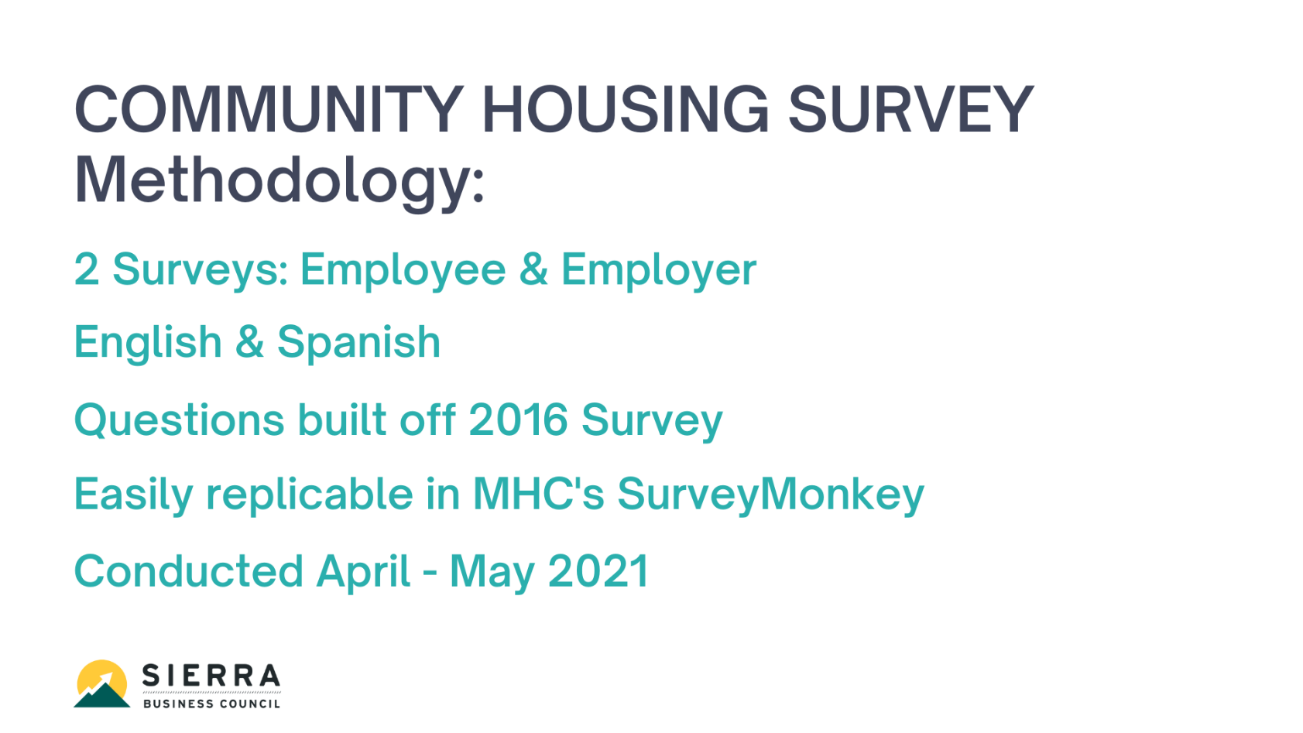
COMMUNITY HOUSING SURVEY - METHODOLOGY

Slide 20
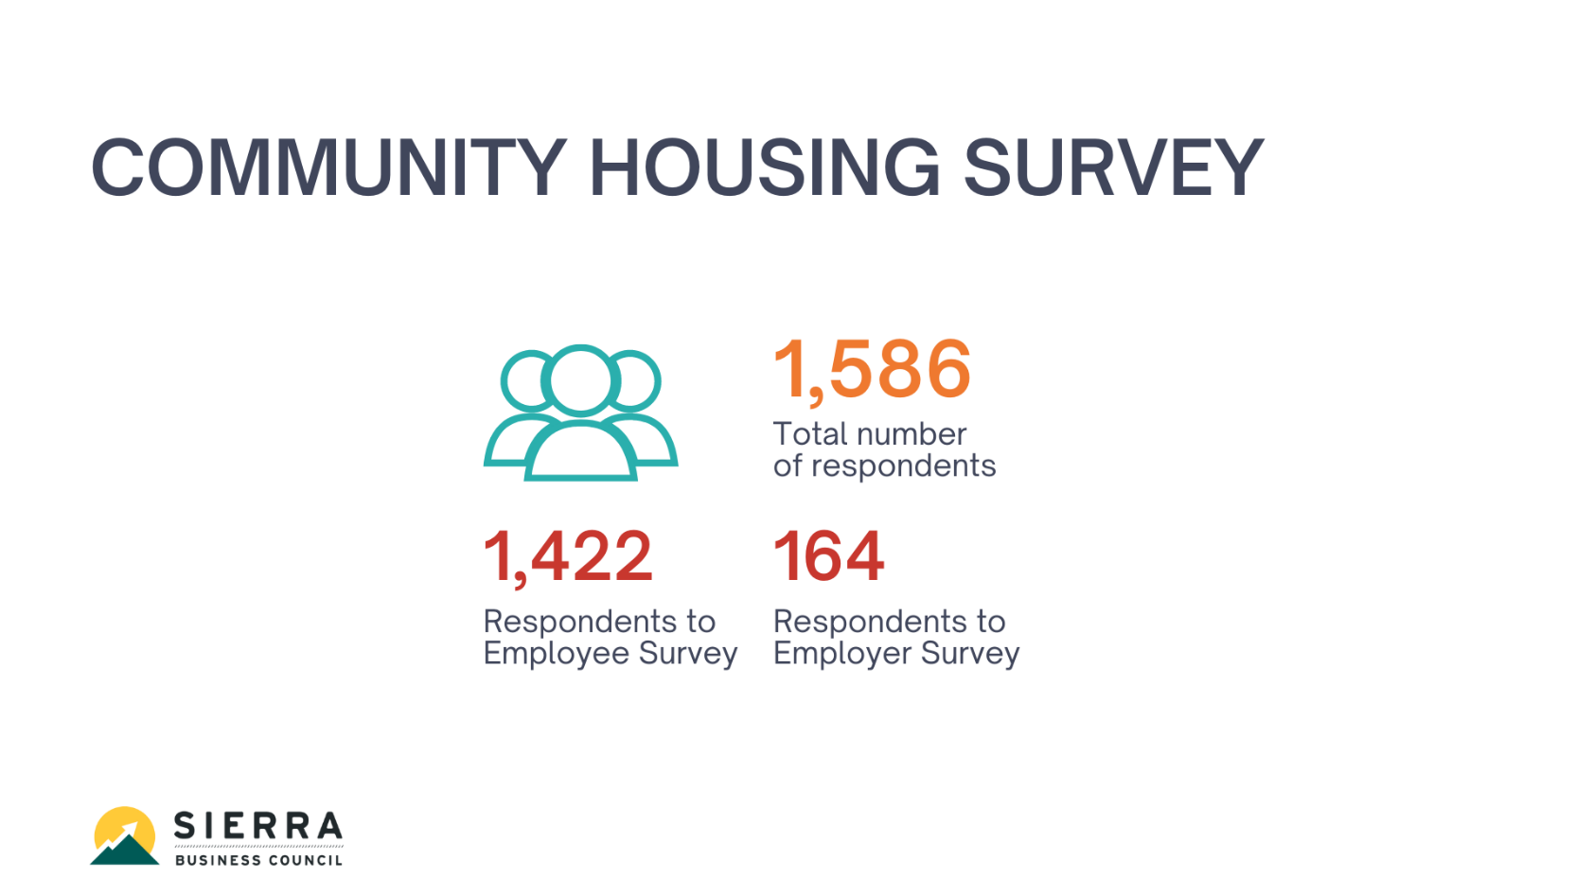
COMMUNITY HOUSING SURVEY

Slide 21
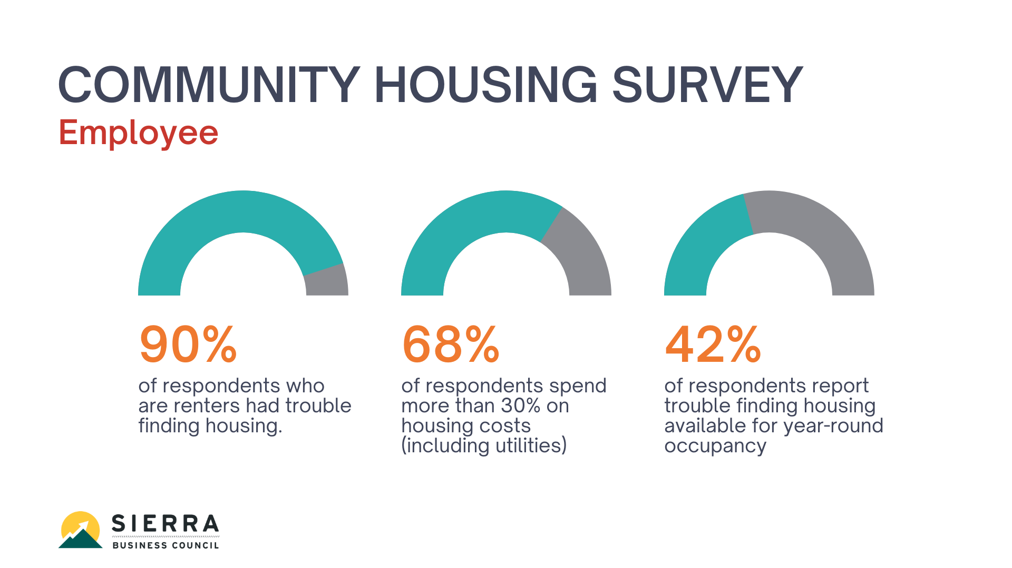
COMMUNITY HOUSING SURVEY - EMPLOYEE

Slide 22
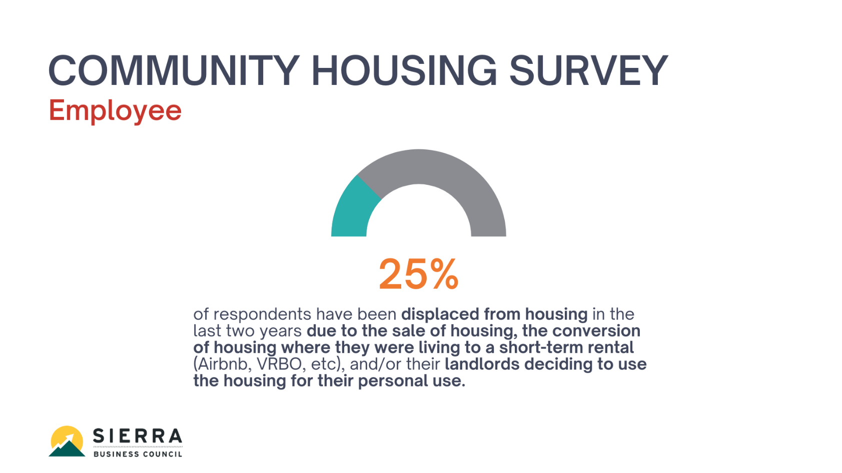
COMMUNITY HOUSING SURVEY - EMPLOYEE

Slide 23
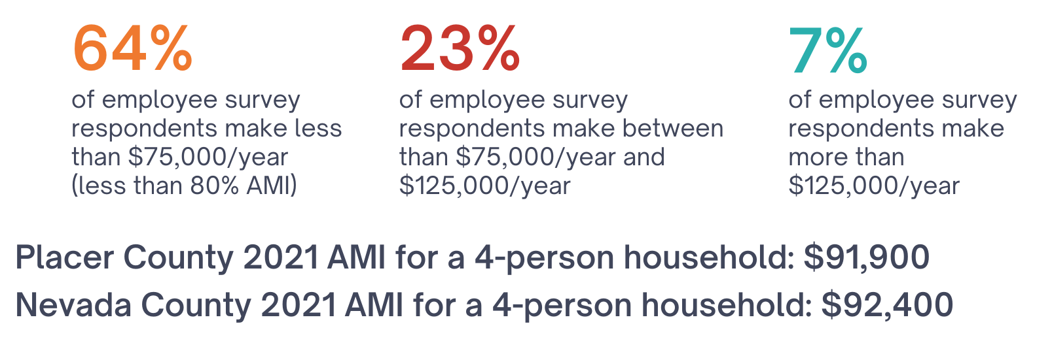
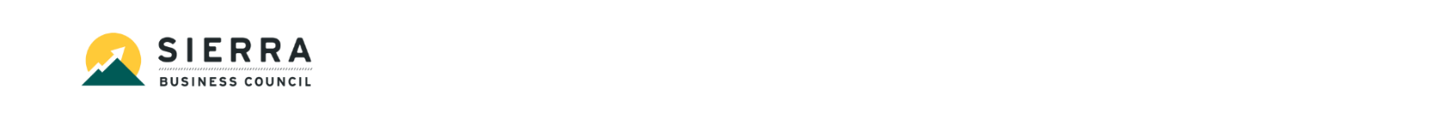
COMMUNITY HOUSING SURVEY – EMPLOYEE

Slide 24
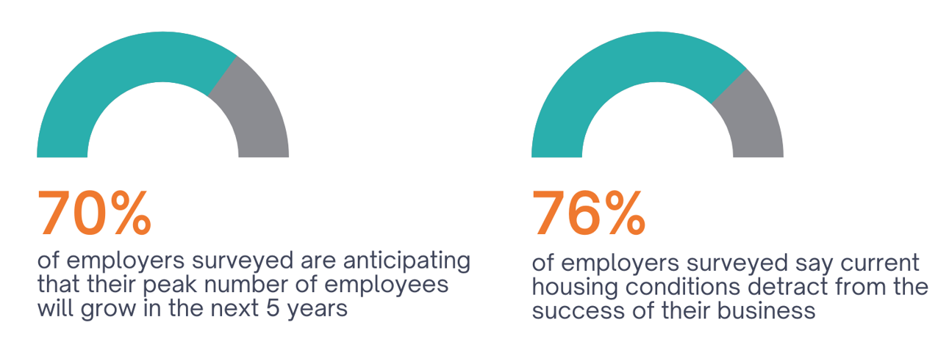
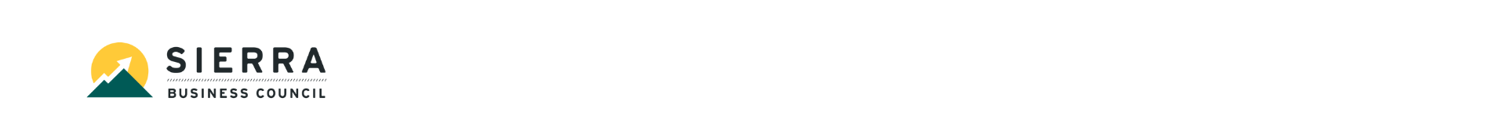
COMMUNITY HOUSING SURVEY - EMPLOYER

Slide 25
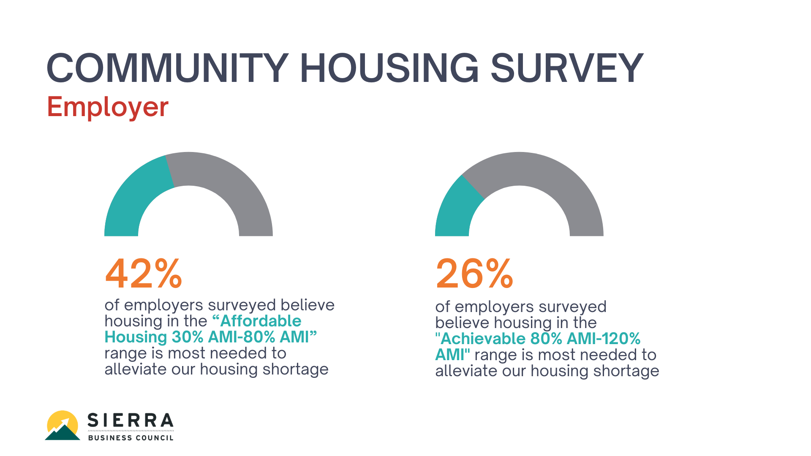
COMMUNITY HOUSING SURVEY - EMPLOYER

